Slide 1
WEB TECHNOLOGY PROJECT
KEVIN MENEZES - CS1920647

Slide 2


TOPIC – QUARANTINE LIFE
PLEASE PUT VOLUME ON AS I HAVE GIVEN EXPLANATION
PRESS Ctrl AND CLICK THE LINK
CLICK TO GO TO PROJECT VIDEO

Slide 3


Slide 4
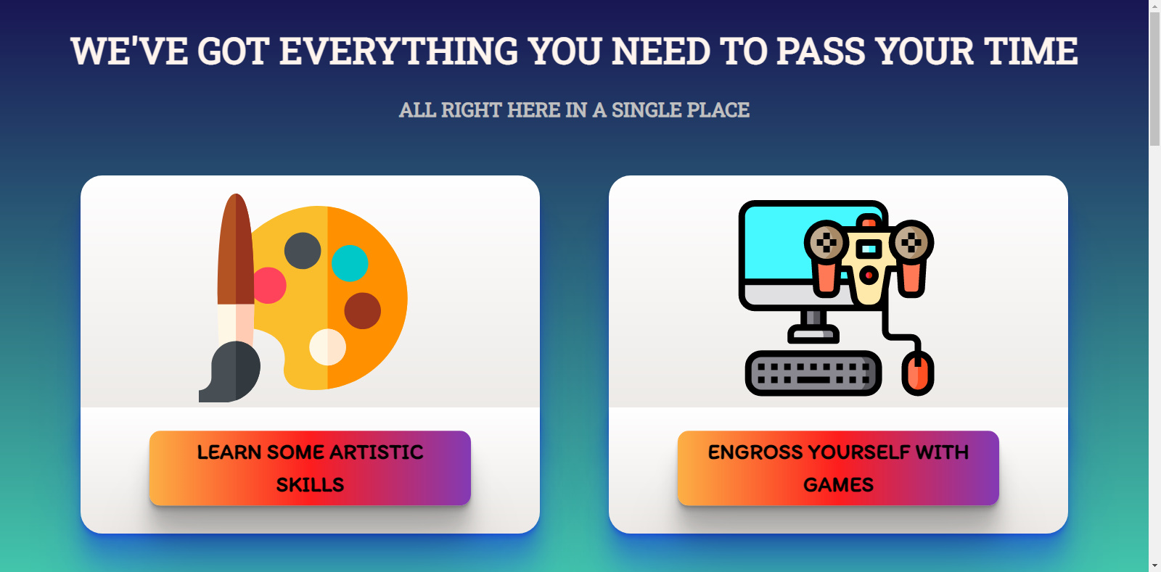

Slide 5


Slide 6
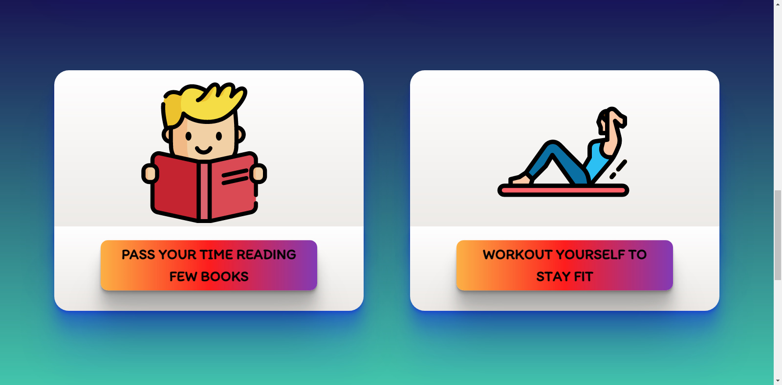

Slide 7
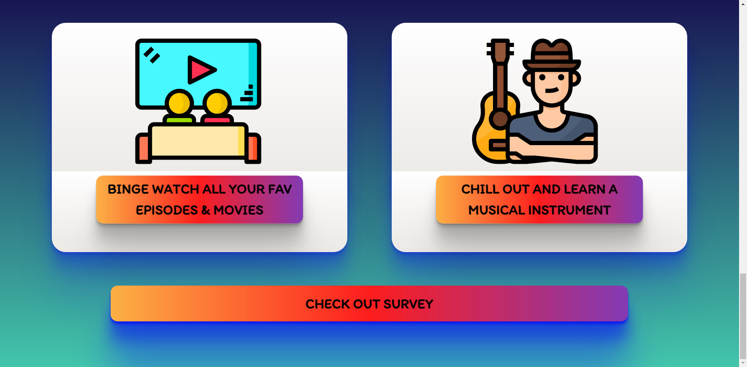

Slide 8
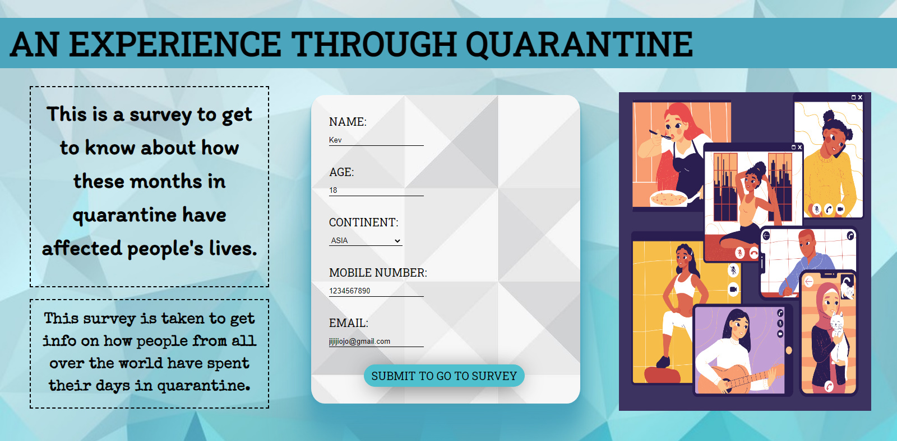

Slide 9
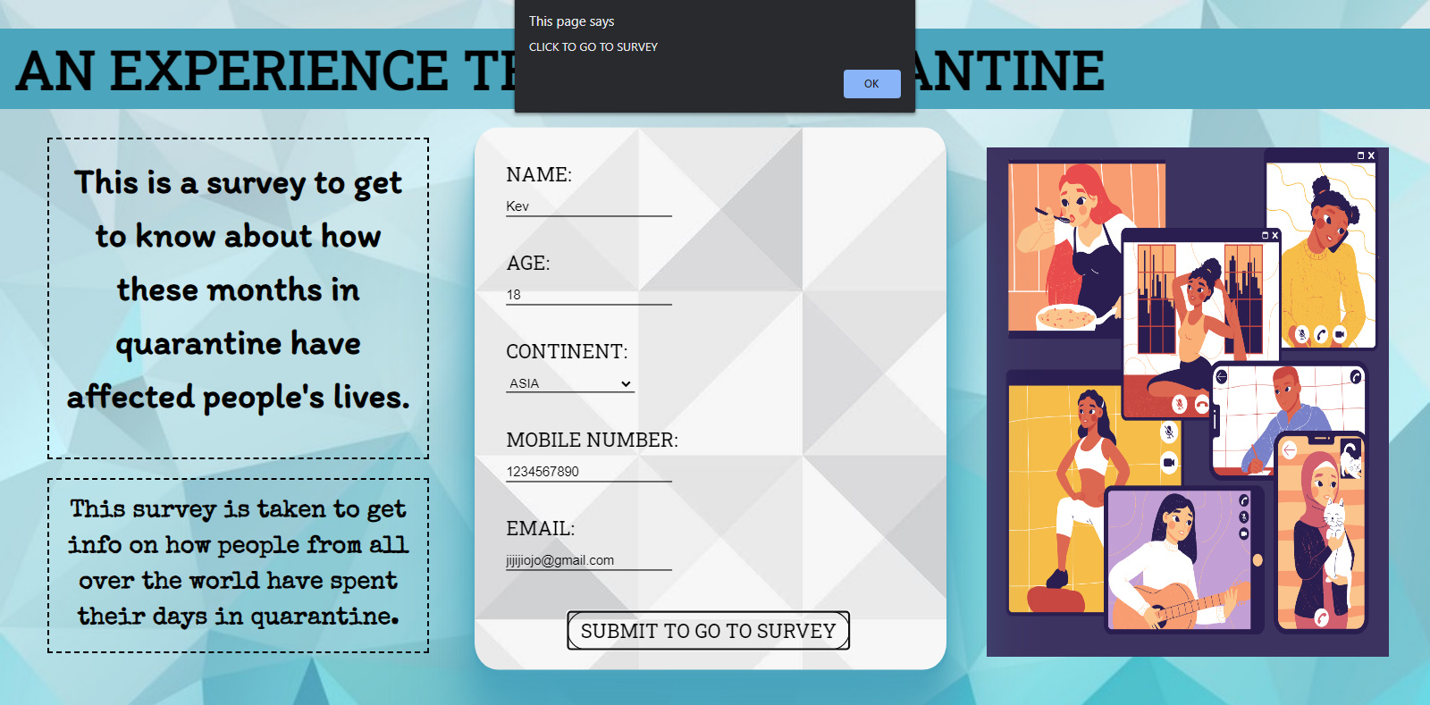

Slide 10
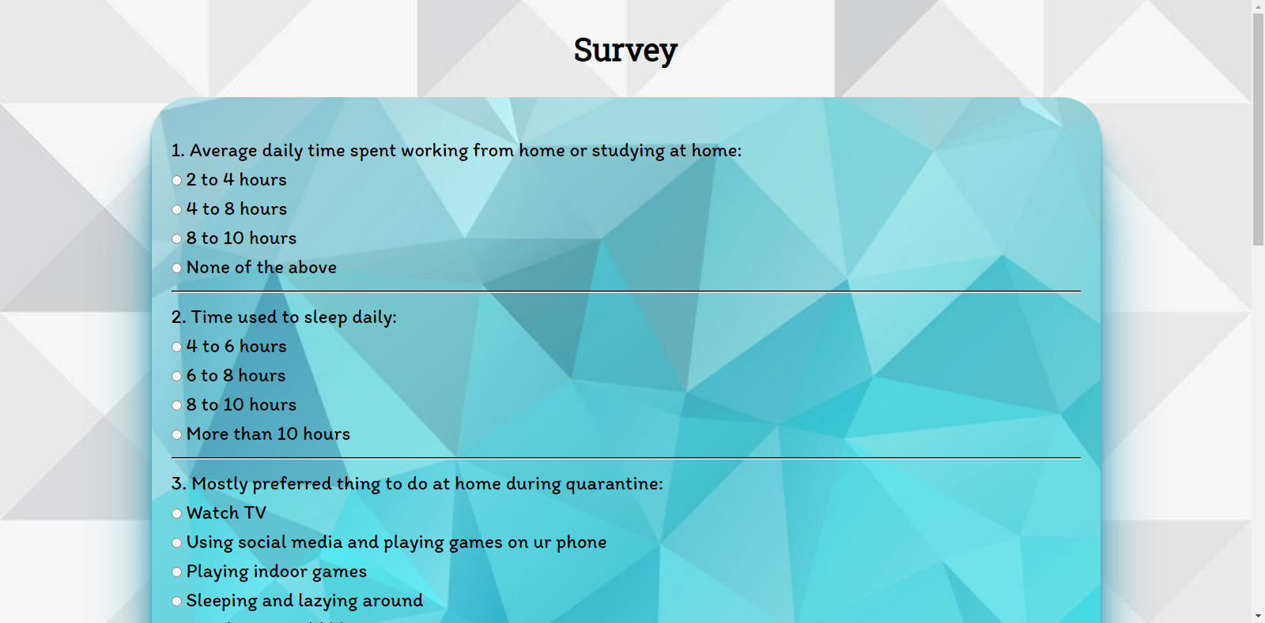

Slide 11
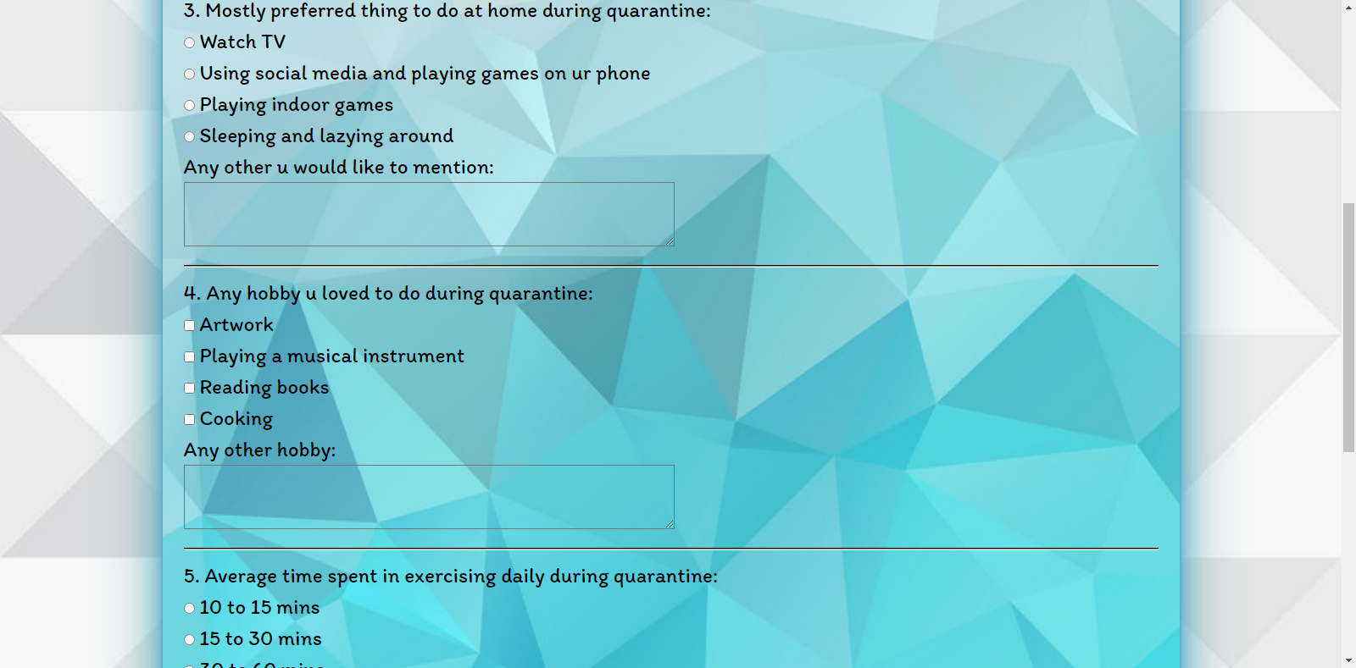

Slide 12
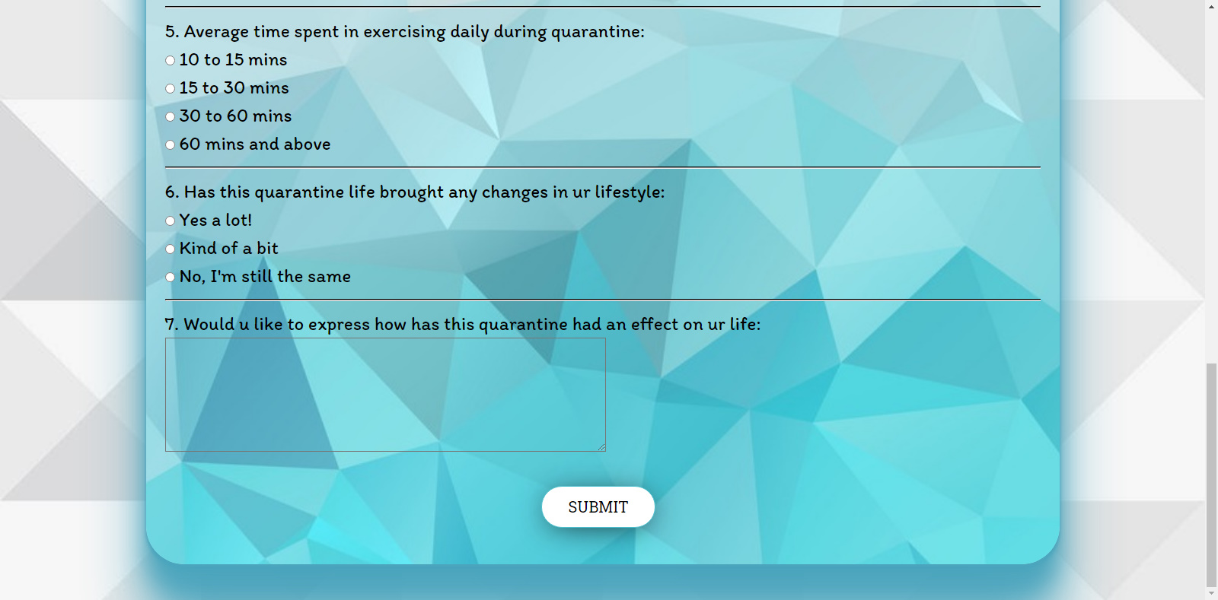

Slide 13
THANK YOU!
KEVIN MENEZES - CS1920647

